Slide 1
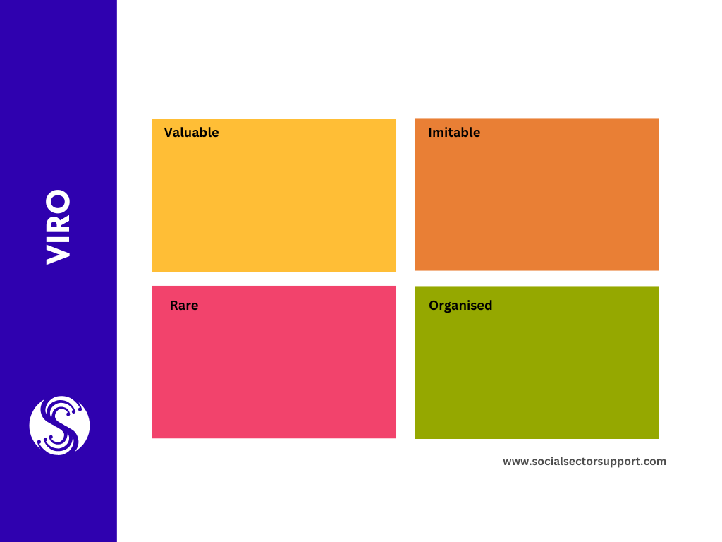
Is what you do or have valuable to others? If so why?
Is what you do or have copyable by others?
Is what you do or have rare?
Is what you do or have organised and usable?

