Slide 1
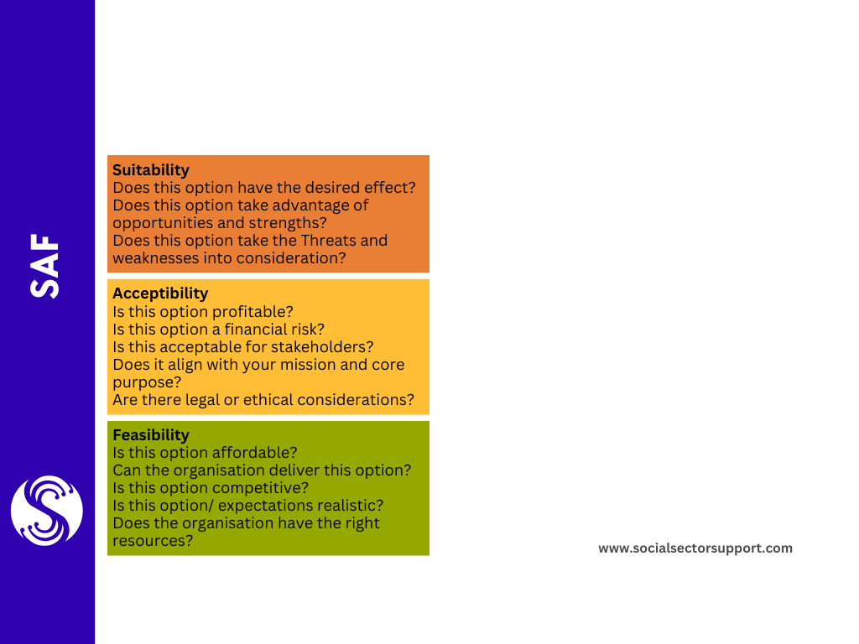
Score each option against each question 1 – 10.
Option 1 | Option 2 | Option 3
Totals:

